Slide 1

NBA Analysis and Machine Learning

Slide 2
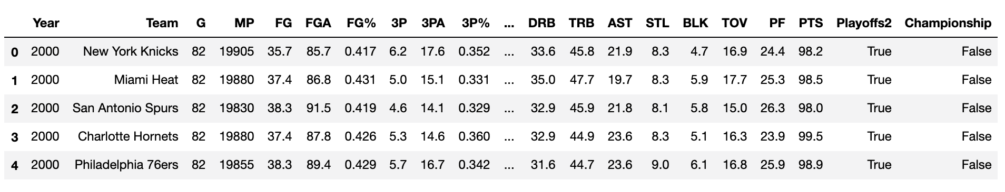
Project Breakdown
We set out with the goal of making the intricate and dynamic data of the National Basketball Association more approachable and understandable by using analytics and machine learning. Then use machine learning to predict future championship teams.

Slide 3
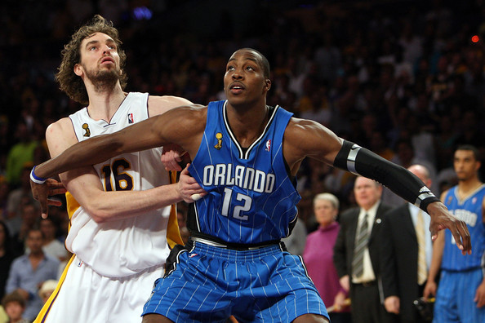
We got boxed out a few times..
Cleaning the data presented a few problems, but Cassian was able to get us a cohesive data set to examine by merging the last 20 seasons, combining the team name changes and defining playoff teams.

Slide 4
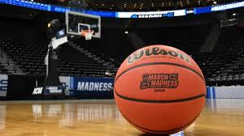
Bringing data onto the court
With a reliable record of NBA data we employed Amazon web services to get the multitude of statistics that make up a championship team together.

Slide 5
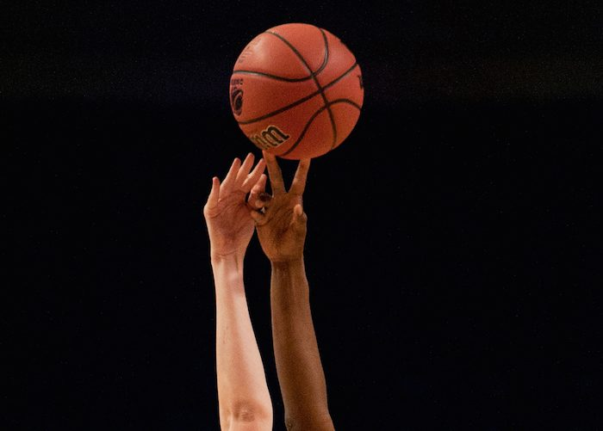
Data tip off
We started by addressing the data at it’s core, what is it that makes a team a champion? From 3-pointers to rebounds, we endeavored to make the data approachable and easy to understand

Slide 6

Taking the data down court
Joel, Steve and Cassian examined the statistics and found trends that could reliably predict what makes a championship team.
https://public.tableau.com/profile/joel.watkins#!/vizhome/NBA_Champion_Analysis/Story1?publish=yes

Slide 7

Reading the court
Jonathon used machine learning to effectively predict a championship team based on the data we had pulled together….
https://colab.research.google.com/drive/1U1VzRifNyCPfyXqklXkVp9KCrbfH-qI1?usp=sharing

Slide 8
Going into Overtime..
Now that we had a working prediction and had analyzed the data in an efficient way, we needed to make it accessible. That’s where Joel came in with his Heroku deployment.
https://jonnybobba.github.io/NBA_Analysis/NBA-App/templates/index2.html

Slide 9
So here’s the venmo, who’s in?
We want to make a bet on the championship team using our machine learning model as a predictor. 5 bucks a person!

